Slide 1
PROasys®
Mike Hyde – Northern Neck EC
Kevin Fulks – Ozark EC (MO)
Bill Ntwali – Aclara

Slide 2
Overview
Common uses of PROasys®
Operate the system stand-alone or in conjunction with other outage systems.
Different ways to view results
Email notifications and map configurations
Understand PROasys® related database tables and their relationships.
Best practices for outage management

Slide 3
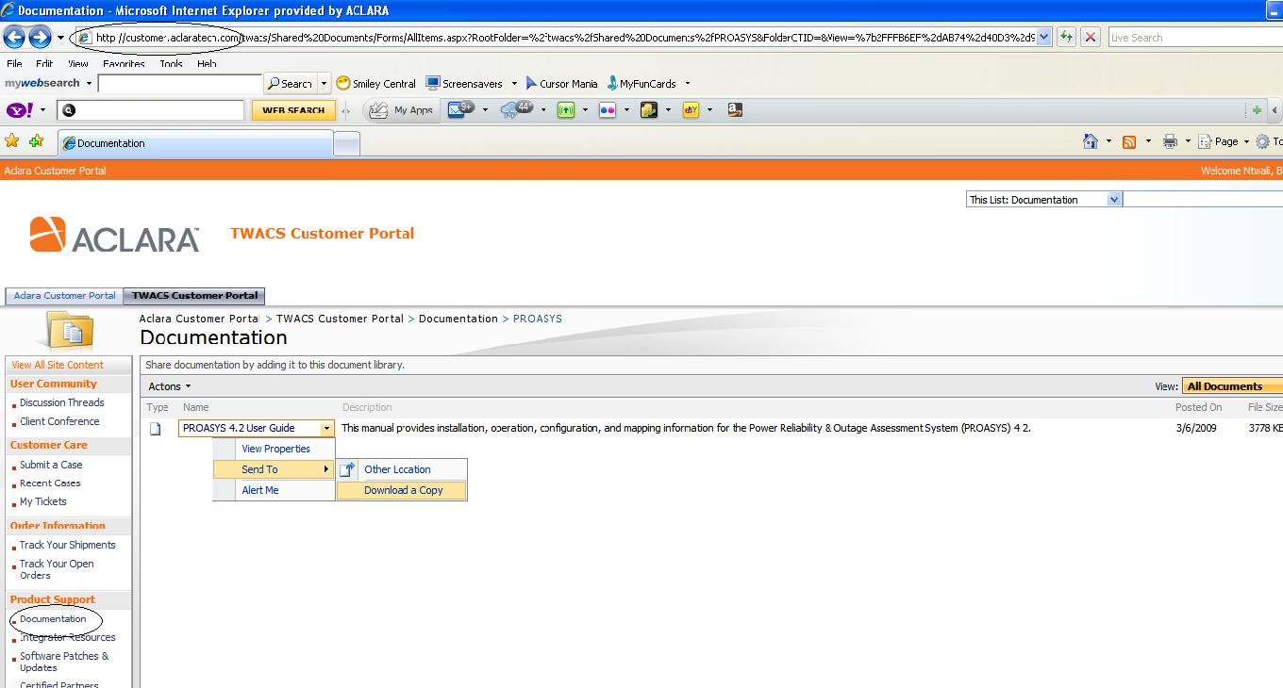
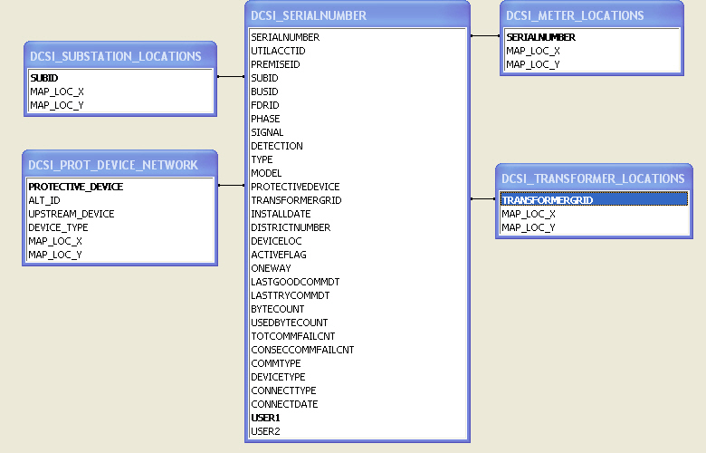
Documentation
Map Data
Minimum Requirements
Serialnumber
Prot_device_network
Substation_locations
Transformer_Locations
Meter_Locations

Slide 4

PROasys®
The PROASYS WebEx is a 120 minute live demo.
Remaining WebEx Classes:
  May 18
  June 9
  July 7
  August 31
  September 8
  October 25
  November 22
  December 10

Slide 5
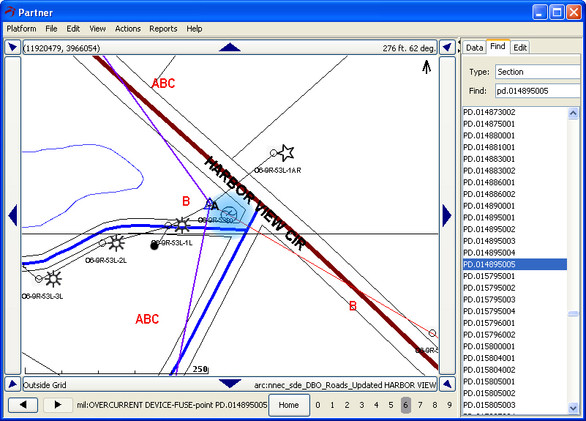
PROasys Ping (Map)
Notes:
Open Map
Click Find
Select “Section.”
Enter “PD.014895005”
Click Zoom level 5
Click “Action,” “List Downstream Members.”
Click “Close”
Click “Action”
Click “Ping downline Members.”
Click “Yes”
Click “Ok”
Minimize map

Slide 6
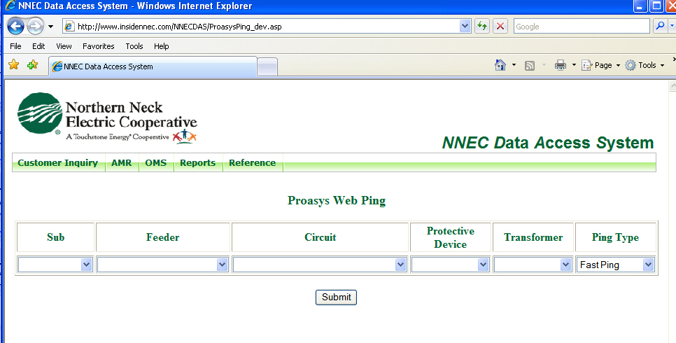
PROasys Ping (Web)
Notes:
Live demo of submitting a PROASYS ping job from Intranet web page.
Open Intranet
NNECDAS
AMR
PROasys Ping
Select “Voltage”
Pick Oak Grove – Tetotum
Minimize Page

Slide 7
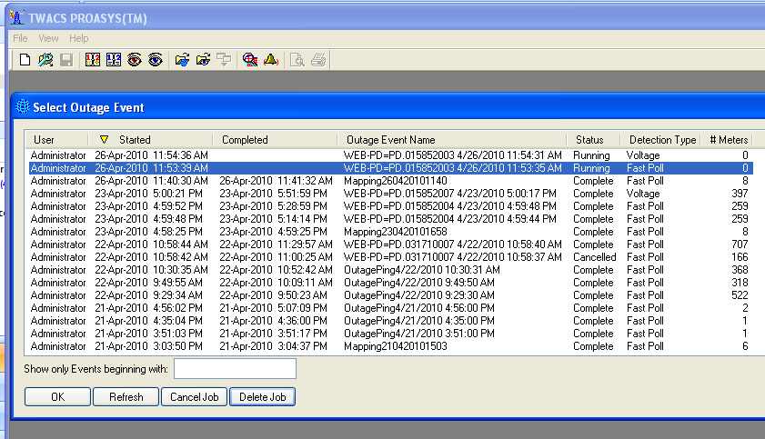
Outage Event
Shows jobs running in PROasys
Notes:
Open PROasys
Click “File”
Select “Open Outage Event.”
Show jobs running

Slide 8
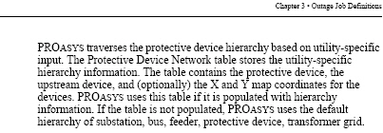
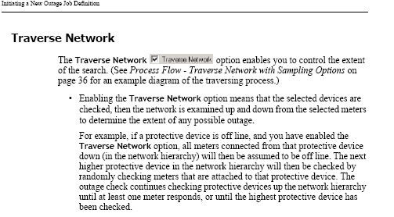
Hierarchy
Traverse Network
(From page 25 of the PROasys User Guide)
(From page 32
of the PROasys
User Guide)

Slide 9
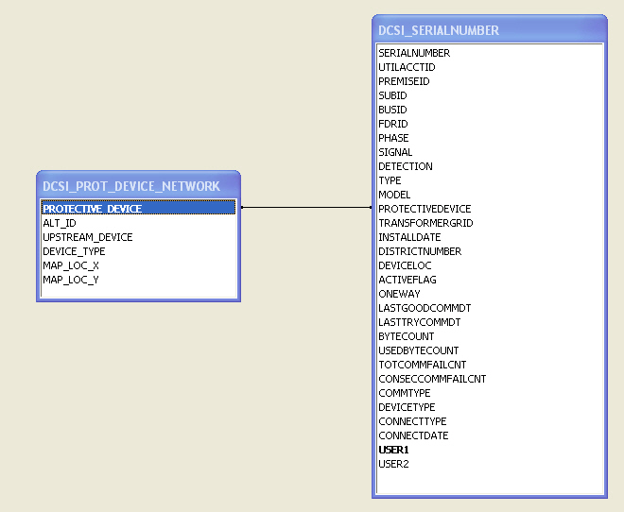
Table Relationships
Minimum Requirements for Traverse Network functionality:
Serialnumber
Prot_device_network

Slide 10
Table Relationships
Minimum Requirements for map display:
Serialnumber
Prot_device_network
Substation_locations
Transformer_Locations
Meter_Locations

Slide 11
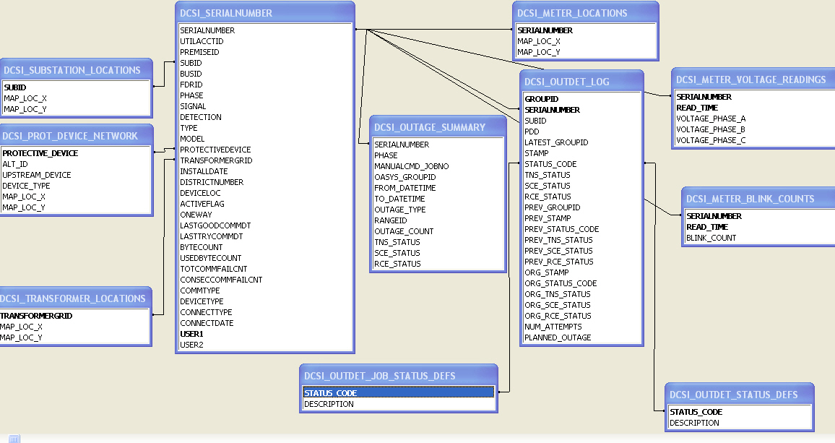
Table Relationships
Hierarchy, Location, Outage, Blink & Voltage

Slide 12
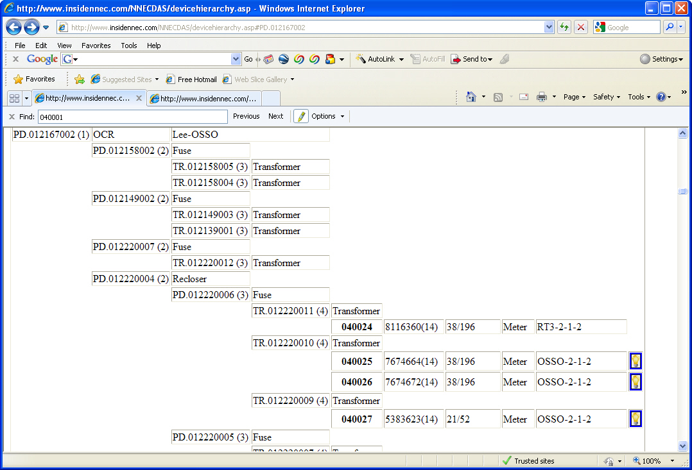
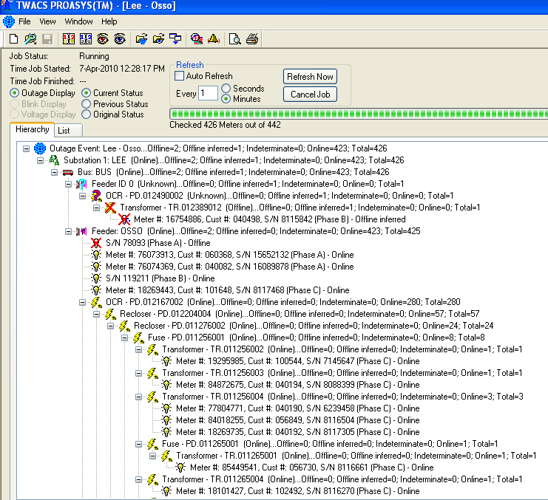
Hierarchy

Slide 13
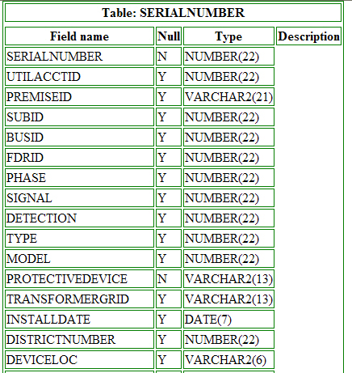
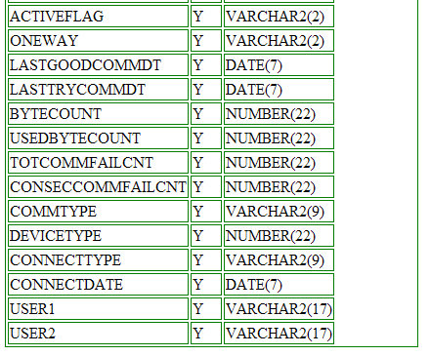
SERIALNUMBER Table

Slide 14
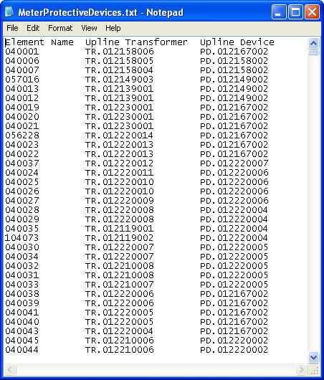
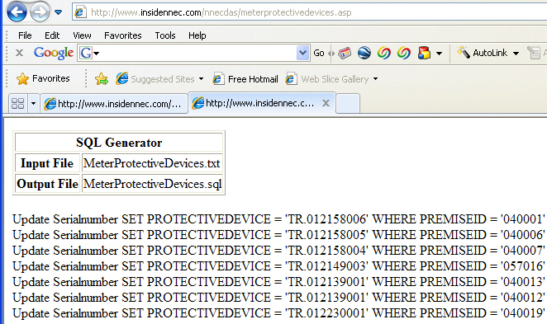
SERIALNUMBER Table
Updating SERIALNUMBER Table
Text file from Milsoft
SQL script generated by utility program

Slide 15
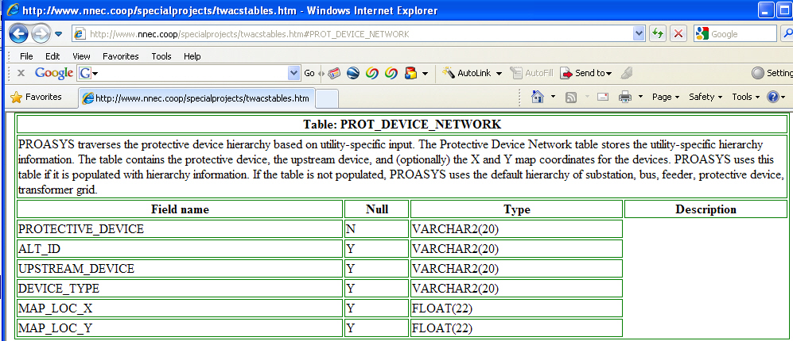
PROT_DEVICE_NETWORK Table

Slide 16
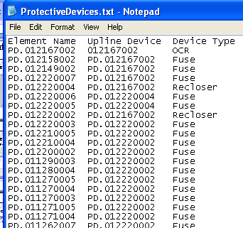
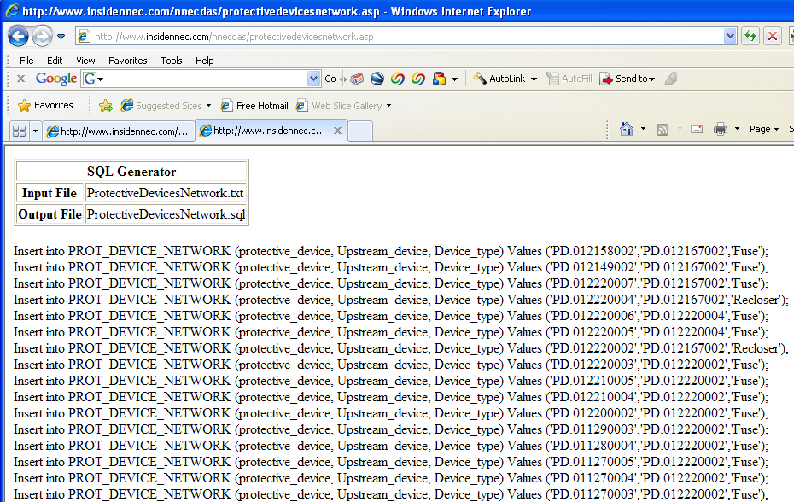
PROT_DEVICE_NETWORK Table
Creating PROT_DEVICE_NETWORK Table
Text file from Milsoft
SQL script generated by utility program

Slide 17
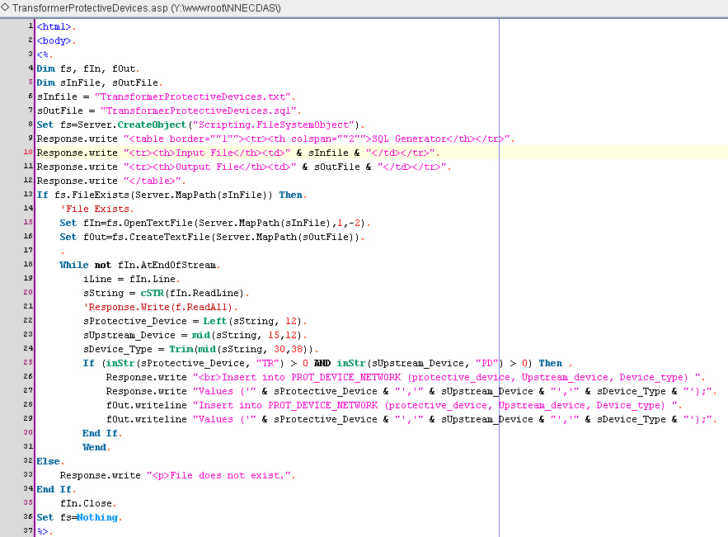
Source Code

Slide 18
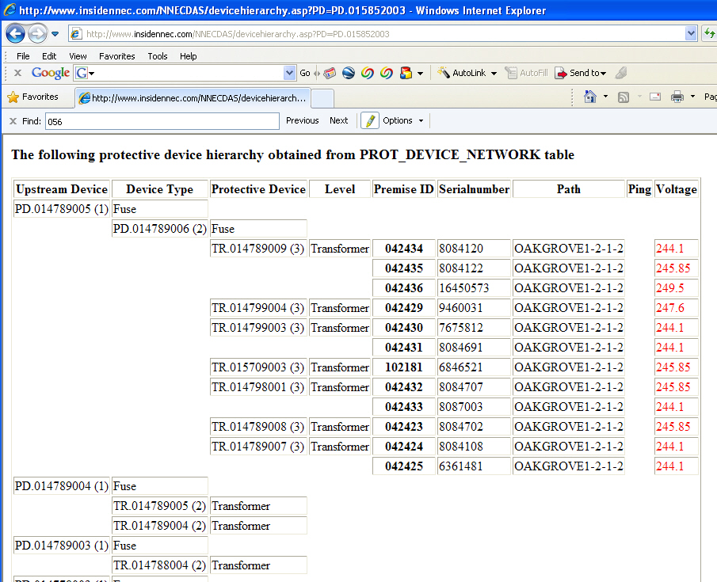
Hierarchy

Slide 19
PROasys Submission
Commands are inputted via SQL into the ODMARM_INPQ table
4 Commands
  START – Starts the new batch job
  Add – Specifies the devices to ping
  Close – Closes the batch job
  Cancel – Cancel the job

Slide 20
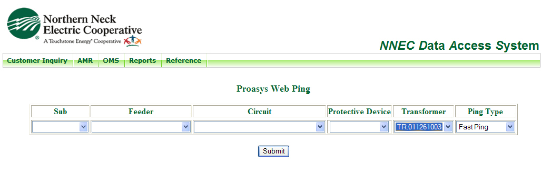
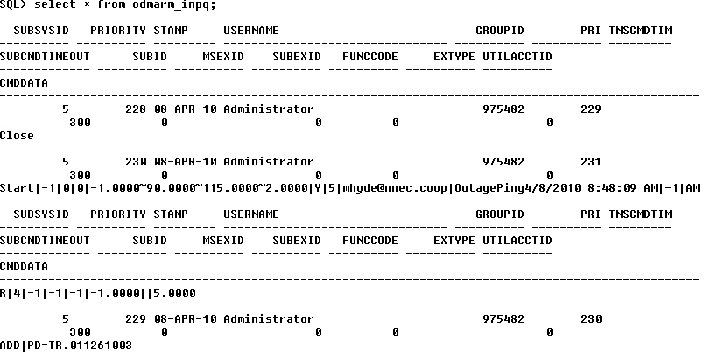
The Meat
The queries used to insert jobs into PROasys

Slide 21
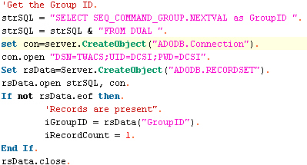

Group ID

Slide 22
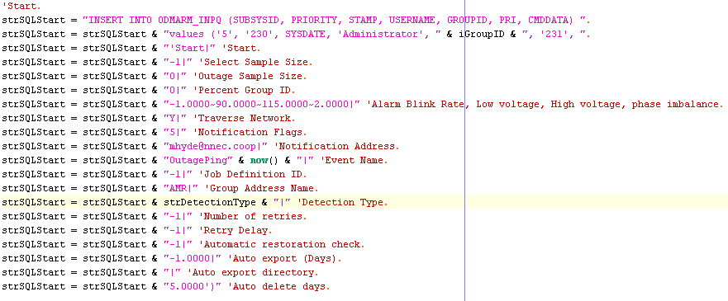
Start Command Creation

Slide 23

Start Command SQL

Slide 24


Add

Slide 25


Close

Slide 26
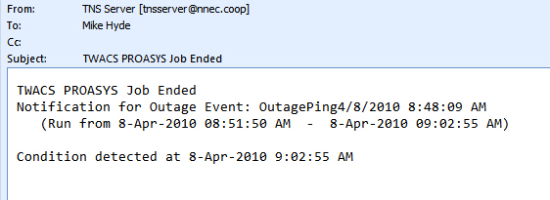
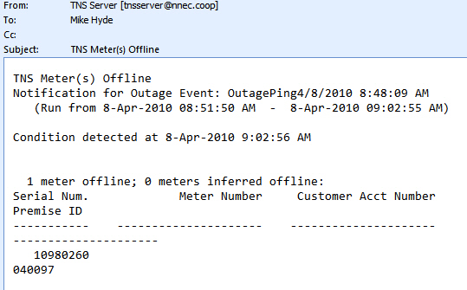
End of Job Actions
Fast Ping (OOB)

Slide 27
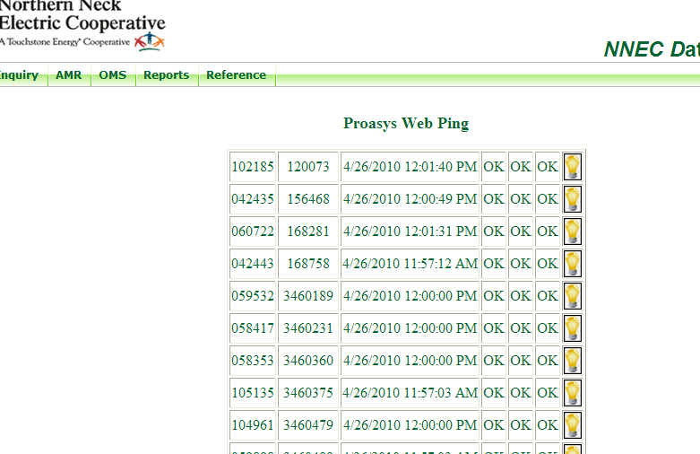
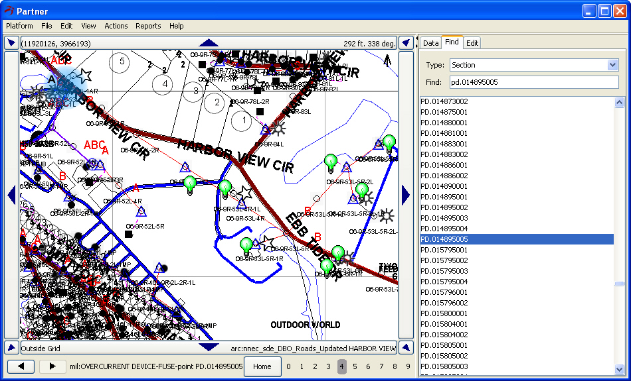
End of Job Actions
Fast Ping (Homegrown)

Slide 28
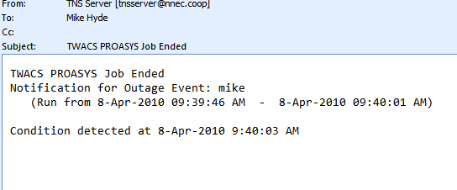
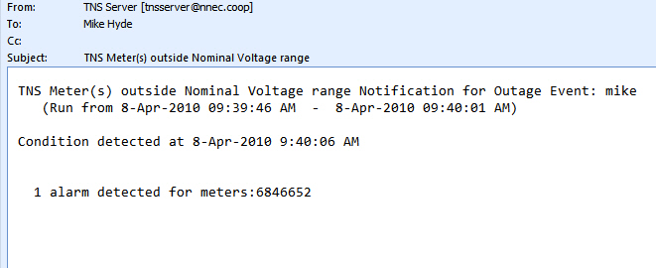
End of Job Actions
Voltage Ping (OOB)

Slide 29
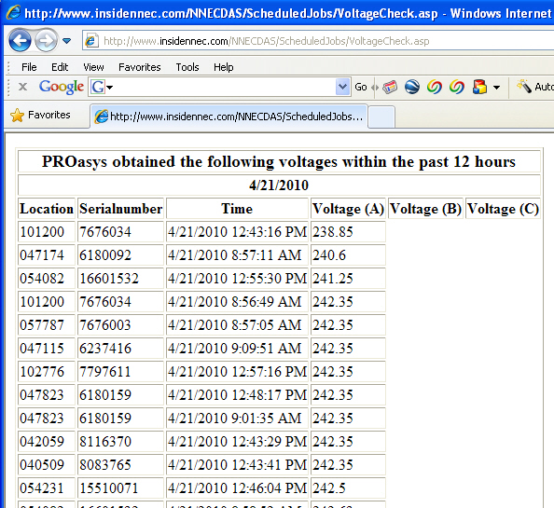
End of Job Actions
Voltage Check - Homegrown

Slide 30
External Data Uses
Meter_Voltage_Reading
Meter_Blink_Counts
Outage_Summary
Outdet_log
Outdet_Status_defs
Outage_Counts
Outage_Summary

Slide 31
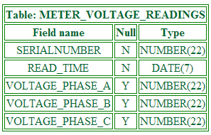
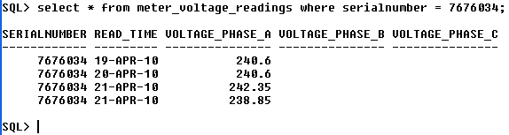
METER_VOLTAGE_READING

Slide 32
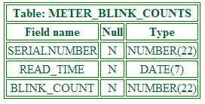
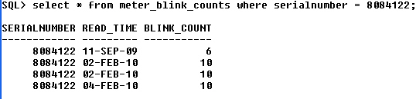
METER_BLINK_COUNTS

Slide 33
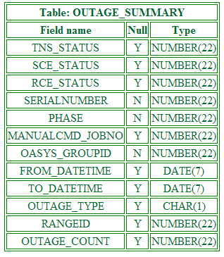
OUTAGE_SUMMARY

Slide 34
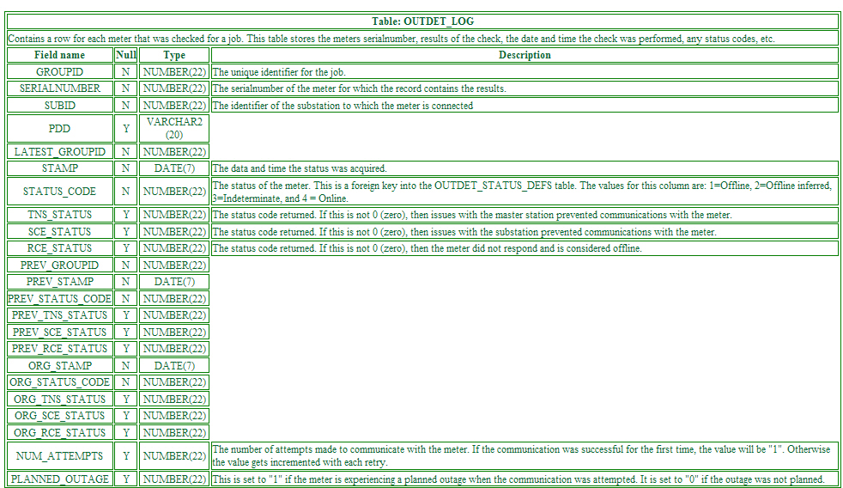
OUTDET_LOG

Slide 35
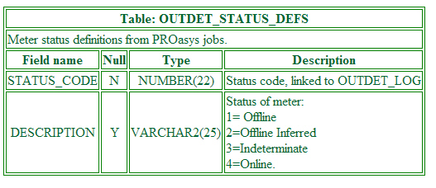
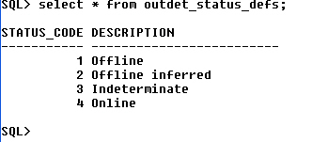
OUTDET_STATUS_DEFS

Slide 36
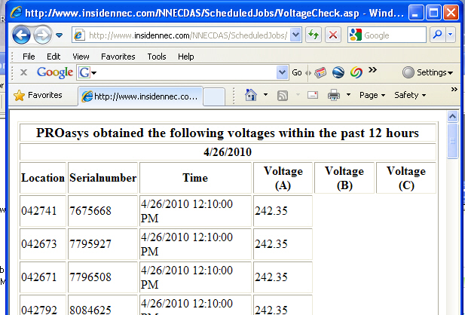
Ping Results (Web - Live)
Ping Results
Report
Notes:
Intranet
NNECDAS
AMR
Voltage Check

Slide 37
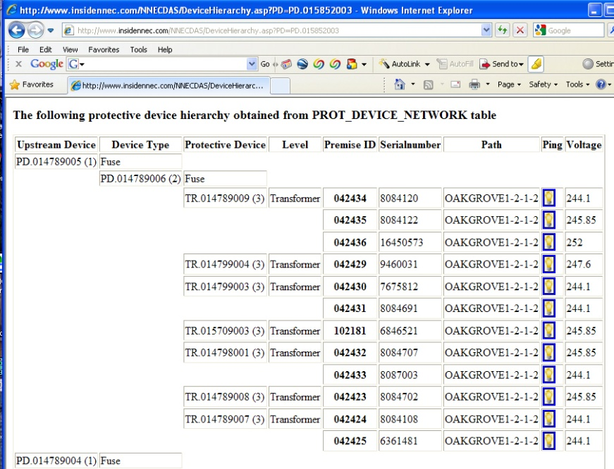
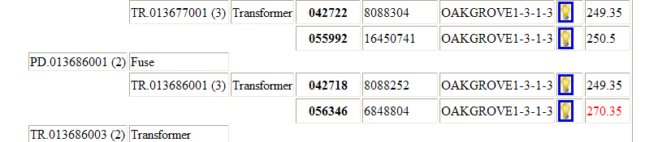
Ping Results (Web - Live)
Ping Results
Device Hierarchy
Notes:
Intranet
NNECDAS
AMR
Device Hierarchy
Select “Oak Grove – Tetotum”

Slide 38
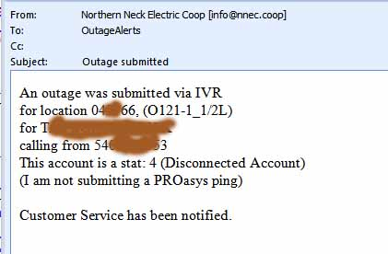
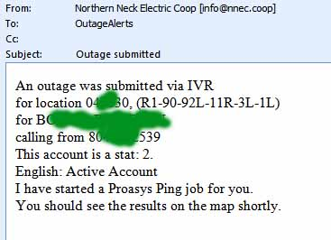
PingBot
Outage Received
Web
IVR
Phone
CRC
Notes:
Intranet
NNECDAS
AMR
Device Hierarchy
Select “Oak Grove – Tetotum”

Slide 39
PingBot
Check Account Status
Active –
  Ping
  Notify Dispatchers &
  Duty Supervisors
  Check ping results
  Notify Dispatchers &
  Duty Supervisors
In-Active
  Notify Customer Service
Notes:
Intranet
NNECDAS
AMR
Device Hierarchy
Select “Oak Grove – Tetotum”

Slide 40
Resources
PROasys User Guide (Y10338TM)
PROasys Third Party Interface Technical Manual (Y10576-TUM)
Table Information
Portal – Discussion Threads
Right here

Slide 41
Future Plans
Map icons – Differentiate Voltage pings
Enhance PingBot
Determine actual failed device
Alerts to trucks (AVL)

